Slide 1
Information Security Data Analytics
16/18 April 2017

Slide 2
Introduction

Slide 3
Verizon Data Breach Report
Questions to answer:
What did you find that was most expected?
What did you find that was most unexpected?
How does the report reconcile with what you know from your position?
How can data be used to answer/address/provide insight into your answers?

Slide 4
Introduction to Basic Statistics
Notes:
While not comprehensive, this section is designed to provide a brief introduction and overview of statistical concepts to help in both understanding why and how to accomplish basic descriptive and inferential analysis of the data you have collected. Once you have an understanding of basic statistical concepts, the application of those concepts in Splunk using Splunk native functions will be covered, then how to engage in a more comprehensive analysis through the integration of Splunk and the statistical programming language R will be examined. Finally, the process of data analysis will be reviewed by stepping through the exploration and managing of data and choosing and validating appropriate statistical models. As this is an overview, much of the material is covered in much greater depth in a variety of different sources. A bibliography will be provided at the end and you are encouraged to engage with those works if you're interested in a fuller understanding.

Slide 5
Variables
Variable - An attribute (characteristics or property) of a subject/object/event that can change between different instances:
Time (e.g. as measured by timestamp on a packet)
Header length
Source Port
Value - The numbers used to describe or represent the characteristic difference.
Time - 09-24-2015 10:45:01.265 +0300
Header length - 20, 20, 45, 60, 20
Source Port - 43234, 45623, 53343
Notes:
Variable - An attribute (characteristics or property) of a subject/object/event that can change between different instances. Examples of a variable include: Time (e.g. as measured by timestamp on a packet) Header length Source Port Value - The numbers used to describe or represent the characteristic difference. Time - 09-24-2015 10:45:01.265 +0300, 09-24-2015 10:40:01.320 +0300, 09-24-2015 10:35:01.257 +0300 Header length - 20, 20, 45, 60, 20 Source Port - 43234, 45623, 53343

Slide 6
Levels of Measurement
Measurement: assignment of values to a variable, according to a certain rule.
Four levels - nominal, ordinal, interval, and ratio.
 | Property | Magnitude | Equal Interval | Absolute Zero
Nominal | No Ordering e.g. Mac, Windows Server 1, etc.
Ordinal | Ordered, but intervals between X elements not same size (e.g 1st, 2nd, 3rd in race) | X
Interval | Equal interval between elements, but no absolute zero | X | X
Ratio | Equal intervals and absolute zero | X | X | X
Notes:
Measurement: assignment of values to a variable, according to a certain rule. There are four levels of measurement that are used when assigning values to variables - nominal, ordinal, interval, and ratio.

Slide 7
Notation and Summation Sign
x1 +x2 +x3 +x4 +x5 +x6 +x7 +x8 +x9 +x10
Works well if we know the exact number of values and that number is small
Tedious if the number of values are anything substantial
Alternative is summation notation:
Notes:
Many of the statistical tools that you will be using rely on basic arithmetic functions, such as addition, subtraction, multiplication, and division. As such, it is important to review related notation and concepts. In equations, we use symbols to represent values, locations, and operations. For example, in the equation $2+3$, the digit symbols '2' and '3' represent the values that we expect, and the '+' sign indicates the operation to perform. If we were missing a value, we might represent it with letter, such as 'x' or 'y' as in $2+x$. If we had many values to sum, and we knew exactly how many numbers there were but not their values, we might represent the operation we want to perform by writing out an equation and using subscripts to indicate which value in the collection of possible values we want to perform the operation on:$$x_1 + x_2 + x_3 + x_4 + x_5 + x_6 + x_7 + x_8 + x_9 + x_{10}$$
While this works well if we know the exact number of values and that number is small, you can imagine how tedious it would be if the number of values were anything substantial. So rather than write out all the variables, we can use other notation to indicate that we want to sum the values from $x_1$ to $x_{10}$ utilizing summation notation:$$\sum_{i=1}^{10} x_i$$

Slide 8
Notation and Summation Sign
What if we don’t know exactly how many numbers there are in the set?
Notes:
Note the number on the bottom indicates where to begin, and the number on top of the symbol (sigma) indicates where to end. In our case, we started at 1 and ended at 10. But what if we don't know exactly how many numbers there are in the set? Then we can indicate that by placing a variable in place of the '10' on top of the summation sign (usually N):$$\sum_{i=1}^N X_i$$

Slide 9
Notation and Summation Sign
Easy to specify operations to apply to a set of numbers
Don’t need to know beforehand how many numbers there are.
For example, if we want to specify the average of a set of values, we could write:
Notes:
This notation makes it easy to specify operations you want to apply to a set of numbers, even if you don't know beforehand how many numbers there are. For example, if we want to specify the average of a set of values, we could write:$$\frac{1}{N}\sum_{i=1}^N X_i$$

Slide 10
Notation and Summation Sign
Symbols for mean (average):
Sample: Population:
Notes:
In fact, we use the average so often that we use other symbols to indicate that we want the average (or mean) of a set. One other symbol that is used is the bar. If we wanted the mean for the entire population of values, we could use a capital letter with a bar over it:$$\bar{X} = \frac{1}{N}\sum_{i=1}^N X_i$$
Another way to indicate that you want the mean of an entire population is to use the greek letter mu:$$\mu = \frac{1}{N}\sum_{i=1}^N X_i$$

Slide 11
Notation and Summation Sign
Product (multiply) of a series:
Notes:
In addition to the use of $\sum$ for addition, we can use a large pi symbol to indicate that we want to get the product (multiply) of a series:$$\prod_{i=1}^{N} x_{i}$$

Slide 12
Describing Datasets
Examine set as whole
Measures of Central Tendency:
Mean
Median
Mode
Measures of spread:
Range
Variance
Standard Dev.
Notes:
If values in a dataset were to be examined individually, it may be hard to get a feeling for the set as a whole. So rather than looking at each member alone, we can contextualize the group of data by taking the values together and describing the set. Measures we often use to describe a set of data include a description of how the distribution of values tend to center using the mean, median, and the mode, and how the distribution tends to spread out using the range, the variance, and the standard deviation. Where in the set the values tend to group and how peaked or flat the group(s) is or are can be described by skew and kurtosis.

Slide 13
Central Tendency - Mean or Expected Score
Mean - Sum of scores divided by the number of scores.
Notes:
Measures of central tendency include the mean, median, and mode. The mean, or expected score, is equal to the sum of the individual scores divided by the number of scores. As seen earlier, the equation for the mean of a population set is:$$\frac{1}{N}\sum_{i=1}^N X_i$$

Slide 14
Central Tendency – Problems with Mean
Affected by extreme (or outlier) scores.
For example:
Notes:
The mean, however, is very affected by extreme (or outlier) scores. For example, if you have 10 people in your unit, but one of them won a lottery and receives an annual payout of $5,000,000, and you calculated the mean of annual income for members of your unit, you would get something like:$$\frac{25000 + 27000 + 27000 + 30000 + 31500 + 31500 + 47000 + 32500 + 32500 + 5000000}{10} = 528600$$
So while the average salary for the unit is $528,600, that certainly doesn't do a good job describing the distribution of salaries.

Slide 15
Central Tendency - Median
Median - better for distributions skewed by some extreme values
Middle ranked score
Divides the distribution into two parts with an equal number of events above and below it.
Order values and take either the middle value (if we have an odd number of events) or calculate the average of the two middle values (for an even number of events).
Notes:
A better measure of central tendency for a distribution that is skewed by some extreme values might be the median, or the middle ranked score. The median divides the distribution into two parts with an equal number of events above and below it. In the example of unit salary, we can rank order the salaries, and take either the middle value (if we have an odd number of events) or calculate the average of the two middle values (for an even number of events):$$25000 + 27000 + 27000 + 30000 + 31500 + 31500 + 32500 + 32500 + 47000 + 5000000$$In the salary case, that would be:$$\frac{31500 + 31500}{2} = 31500$$

Slide 16
Central Tendency – Median Example

Slide 17
Central Tendency - Mode
Mode - the most frequently occurring value
Value is the peak in a frequency distribution
A distribution can have many modes (or be multi-modal)

Slide 18
Variability - Range
Range - the difference between the maximum value and the minimum value in a set:
Notes:
In addition to identifying the measures of central tendency, it's also often important to understand how the data are spread out. The most basic measurement of variability is the range. The range is simply the difference between the maximum value and the minimum value in a set:$$Range = maximum - minumum$$

Slide 19
Variability – Variance
We denote the population variance, defined as the average of the sum of the squared deviations, with the Greek letter sigma squared (dividing by N) and the sample variance with a lowercase s squared (dividing by n-1):
Notes:
While the range provides the overall spread of the data, we are also often interested in how the data spreads from the mean as a measure of central tendency. This will let us know whether most values center around the mean or whether the values are really spread out and is important as it allows us to make several inferences about the nature of the data. The two other measures of variability we are interested in are the *variance* and the *standard deviation*.
The variance of a set of data is defined as the average of the sum of the squared deviations, which while sounding like a mouthful, is really just a matter of taking the difference between each score and the mean (which will give both positive and negative numbers that would sum to 0) and squaring that value (which gets rid of the negative values since a negative times a negative is a positive), adding all those values up (which due to squaring now don't sum to 0) and dividing by the total number of scores you have (if it's a population, otherwise if it's a sample, by one less than the total number you have). We denote the population variance with the greek letter sigma squared (dividing by N) and the sample variance with a lowercase s squared (dividing by n-1):Population: $\sigma^2 = \frac{\displaystyle\sum_{i=1}^{N}(X_i - \mu)^2} {N}$Sample: $s^2 = \frac{\displaystyle\sum_{i=1}^{n}(x_i - \bar{x})^2} {n-1}$

Slide 20
Variability – Standard Deviation
The problem with variance is that since we have squared the differences, the units of the measurement are also squared, which doesn’t always make sense. So we can take the square root of the variance to get the standard deviation:
Notes:
The problem with variance is that since we have squared the differences, the units of the measurement are also squared, which doesn't always make sense. So we can take the square root of the variance to get the *standard deviation*:Population: $\sigma = \sqrt{\frac{\displaystyle\sum_{i=1}^{N}(X_i - \mu)^2} {N}}$Sample: $s = \sqrt{\frac{\displaystyle\sum_{i=1}^{n}(x_i - \bar{x})^2} {n-1}}$

Slide 21
Z-Score
Now we can combine our measures of central tendency and our measures of variability together in order to generate a standardized score that allows us to compare scores from different distributions.
The standard score, or Z score, is a measure of how many standard deviations a score is from the mean.
The properties of a distribution converted to Z scores is known. It will have a mean of 0 and a standard deviation of 1.
You can calculate a Z score for any value by taking the original value, subtracting the mean and dividing by the standard deviation

Slide 22
Variability – Z-score
Calculate the Z score for each admin:
Measure | Admin1 | Admin2
Connections per Minute (X) | 80 | 80
Mean | 85 | 35
Standard Dev. | 10 | 5
Notes:
For example, let’s say you’re supervising a couple of network administrators, and you call the first and ask how many connections per minute to port 1234 are being made. The admin says 80, you thank them, and call the second admin and ask the same question. That admin tells you 80 as well. If you had no further information, you may be inclined to treat them as equivalent, but since you’re an analyst, you compare the number of connections per minute against what the ‘normal’ for that system is by calculating the respective z-scores.

Slide 23
Variability – Z-score
Notes:
So compared with what is ‘normal’ for the systems, the amount of traffic heading to port 1234 for the system run by admin 2 represents a significant change from the expected number of connections per minute (mean value), so definitely something to investigate!

Slide 24
Skewness and Kurtosis
Skew represents how symmetric or asymmetric the data is with respect to the center. The formula for skewness is:
Notes:
Our last way to characterize the data are by examining the skew and kurtosis. Skew represents how symmetric or asymmetric the data is with respect to the center. If the data has a long tail to the left, meaning that there are proportionally more values in the left tail than on the right, than we say it has a negative skew. If the tail on the right is proportionally larger, we say the data has a positive skew. The formula for skew is:$$\left(\frac{X - \mu}{\sigma}\right)^{3}$$

Slide 25
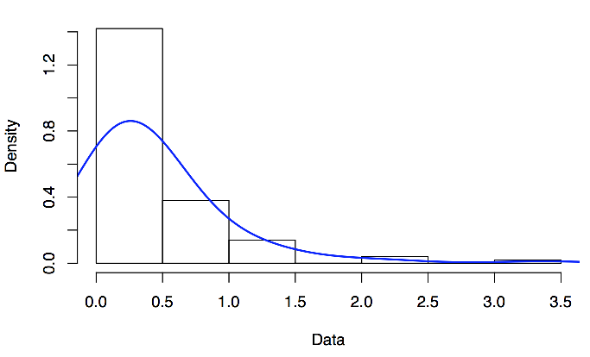
Skewness and Kurtosis – Positive Skew
Notes:
An example of positive and negative skew:

Slide 26
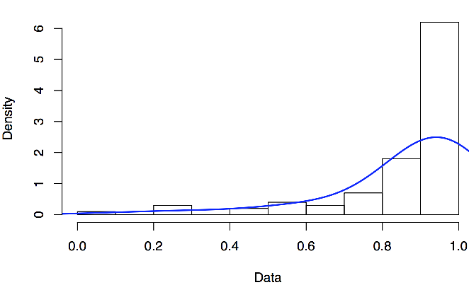
Skewness and Kurtosis – Negative Skew

Slide 27
Skewness and Kurtosis
Kurtosis indicates how peaked or flat the data is. The formula for kurtosis is:
Notes:
Kurtosis indicates how peaked or flat the data is. The formula for kurtosis is:$$\left( \frac{X - \mu}{\sigma} \right)^{4}$$

Slide 28
Distributions - Frequency
Frequency, or how often something occurs, is an important concept for probability and statistics. With an understanding of frequency, we can predict how likely or how often an event might occur.
Frequency distributions - indicate counts of observed events in a given interval
Relative frequency distributions - indicate the *proportion* of events observed at each interval
Cumulative frequency distributions - the sum of the frequencies of events for a given interval and all preceding intervals
Cumulative relative frequency distributions - the cumulative frequencies as a proportion of the total number of events.
Notes:
Frequency, or how often something occurs, is an important concept for probability and statistics. With an understanding of frequency, we can predict how likely or how often an event might occur. Since frequency is so important, we have several ways to measure it. These include *frequency distributions*, which indicate counts of observed events in a given interval, *relative frequency distributions*, which indicate the *proportion* of events observed at each interval, *cumulative frequency distributions*, which are the sum of the frequencies of events for a given interval and all preceding intervals, and *cumulative relative frequency distributions*, which are the cumulative frequencies as a proportion of the total number of events.

Slide 29
Distributions - Frequency
Example - Imagine you have to measure how well units secure their information infrastructure. You develop a measurement instrument that scores the unit on a scale from 1 to 5 and then measure the security of 20 units:
Score | Freq | Rel Freq | Cum Freq | Cum Rel Freq
5 | 3 | 3/20=0.15 | 20 | 20/20=1.0
4 | 4 | 4/20=0.20 | 17 | 17/20=.85
3 | 6 | 6/20=0.30 | 13 | 13/20=.65
2 | 4 | 6/20=0.20 | 7 | 6/20=.35
1 | 3 | 3/20=0.15 | 3 | 3/20=.15
Total: | 20
Notes:
An example is likely instructive. Imagine you have to measure how well units secure their information infrastructure. You develop a measurement instrument that scores the unit on a scale from 1 to 5 and then measure the security of 20 units:

Slide 30
Distributions – Frequency Plots
Histogram - discrete bin widths in which the count of events that fall within the bin are shown, but that loses some information since you don’t know what the exact values were that placed the event in the bin
Stem and Leaf - show the count within the bin, but also the unique value that placed it there
Notes:
Frequencies are often plotted as histograms or stem and leaf plots to examine the shape of the frequency distribution. Histograms have discrete bin widths in which the count of events that fall within the bin are shown, but that loses some information since you don’t know what the exact values were that placed the event in the bin. Stem and leaf plots account for that by not only showing the count within the bin, but also the unique value that placed it there.

Slide 31
Distributions – Frequency Plots Example
Imagine you have the following data:
5 | 6 | 10 | 10 | 11
15 | 16 | 21 | 22 | 22
25 | 25 | 26 | 26 | 27
27 | 28 | 28 | 30 | 30
31 | 35 | 36 | 40 | 41

Slide 32
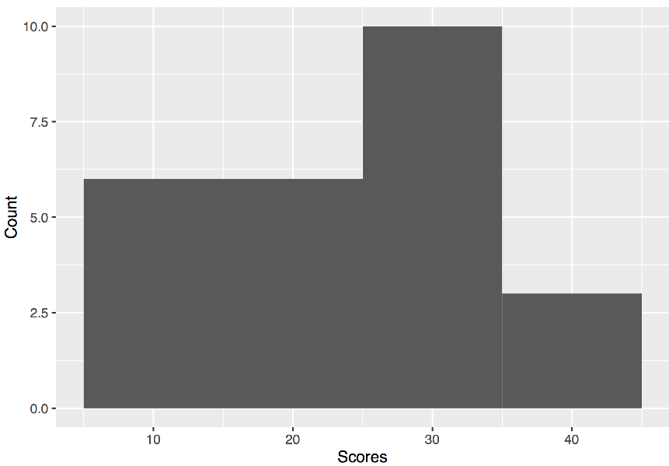
Distributions - Frequency
We can plot that in a histogram, but we’ll lose the individual values when we put them in a bin:

Slide 33
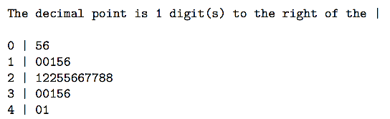
Distributions - Frequency
If we create a stem and leaf plot, we can still see the distribution but we also see the individual values:
Notes:
To better understand frequency distributions, we can relate the values to measurements you likely are already familiar with. When constructing the bins for a frequency distribution, you have to decide how wide to make them. There are a variety of best practices, but intuitively you should be able to see that the wider the bin, the more values it will encompass. Conversely, the smaller the bin, the fewer values it will encompass. Think of the bin size as volume. The actual values you can consider mass. So the more values per unit volume, the greater the density for that area. If we were to have a relatively small bin size, but had a lot of values, that would be a very dense area for recorded events. If we kept the volume constant and had fewer counts in an area, the density of events for that area would be less. This will become more important when we start to discuss various known distributions, but before that, we need examine other measures that describe distributions.

Slide 34
Distributions - Quantitative or Qualitative
Qualitative, or categorical, data – can separate the values into categories that are described by some characteristic of the item.
Quantitative data - numerically measured and is further divided into:
Discrete variables
can take on values from only a distinct set of possible values
the relative frequency distribution of the discrete variable is the probability that the variable will take on that specific value
Continuous variables
measurements that can take on an infinitely precise value
Notes:
In the previous sections we've covered frequency, measures of central tendency, and variability. We can put them together to talk about issues of likelihood or probability. When doing measurement, we can divide the data broadly into two categories: qualitative or quantitative. Qualitative, or categorical, data allows one to separate the values into categories that are described by some characteristic of the item. For example, we can categorize computers by the operating system they run. Although that may seem trivial, the relative frequencies of the operating systems reflect the probability of getting a computer with a given OS if you were to randomly sample a computer from the population of computers.

Slide 35
Distributions - Qualitative
Categorize computers by the operating system they run
Relative frequencies of the operating systems reflect the probability of getting a computer with a given OS if you were to randomly sample a computer from the population of computers

Slide 36
Distributions – Qualitative - Exampe
Imagine that in a unit of 100 computers, most run Windows OS (90/100), some computers run OS X (6/100), and few computers run Linux (4/100). A table of probabilities (relative frequencies) could be constructed that would indicate how likely you would get a computer with each OS if one were chosen at random
Operating System | Probability
Windows OS | 0.90
Mac OS | 0.06
Linux | 0.04

Slide 37
Distributions – Quantitative, Discrete Bernoulli
Quantitative variables can be divided into discrete and continuous variables
A discrete variable can take on values from only a distinct set of possible values
Simplest discrete variable would consist of only two possibilities, such as correct or incorrect, present or not present, and heads or tails.
Notes:
In addition to qualitative variables, we also have quantitative variables. Quantitative variables can be divided into discrete and continuous variables. A discrete variable can take on values from only a distinct set of possible values, with the relative frequency distribution of the discrete variable being the probability that the variable will take on that specific value. The simplest discrete variable would consist of only two possibilities, such as correct or incorrect, present or not present, and heads or tails.
For example, let’s say we wanted to know what the probability was of finding an infected machine on the network. If we were able to detect with 100% confidence whether a machine was infected or not, and took a sufficiently large sample of machines and counted all the machines that were infected, we could estimate the probability of having an infected machine in the population. The random variable is binary so it is either infected or not infected. We can describe this special case with what is called the Bernoulli distribution.

Slide 38
Distributions – Bernoulli Example
For example, let’s say we wanted to know what the probability was of finding an infected machine on the network. If we were able to detect with 100% confidence whether a machine was infected or not, and took a sufficiently large sample of machines and counted all the machines that were infected, we could estimate the probability of having an infected machine in the population. The random variable is binary so it is either infected or not infected. We can describe this special case with what is called the Bernoulli distribution.

Slide 39
Distributions - Bernoulli
The Bernoulli distribution describes the probability of each outcome and the associated variance:

Slide 40
Distributions - Poisson
The type of distribution commonly used when measuring counts per some unit (time, area, etc.) is the Poisson distribution probability mass function, which gives the probability of observing ‘x’ counts in any random unit
Described by the equation:
where x! stands for x factorial, or the product of each value in x. The mean and variance of the Poisson distribution are both μ.

Slide 41
Distributions – Poisson - Example
Suppose we wanted to examine the behavior of the machines over the course of a week so we can baseline what ‘normal’ looks like. We have a set of machines that reflect the machines in our network and we know they are not infected. We decide to count the number of times the machines connect to other computers on the internal network each minute, and come up with the following distribution:
Notes:
Now suppose we wanted to examine the behavior of the machines over the course of a week so we can baseline what 'normal' looks like. We have a set of machines that reflect the machines in our network and we know they are not infected. We decide to count the number of times the machines connect to other computers on the internal network each minute, and come up with the following distribution:
The type of distribution commonly used when measuring counts per some unit (time, area, etc.) is the Poisson distribution probability mass function, which gives the probability of observing 'x' counts in any random unit (in our case minute), and can be described by the equation:$$P\left( x \right) = \frac{{e^{ - \mu } \mu ^x }}{{x!}}$$

Slide 42
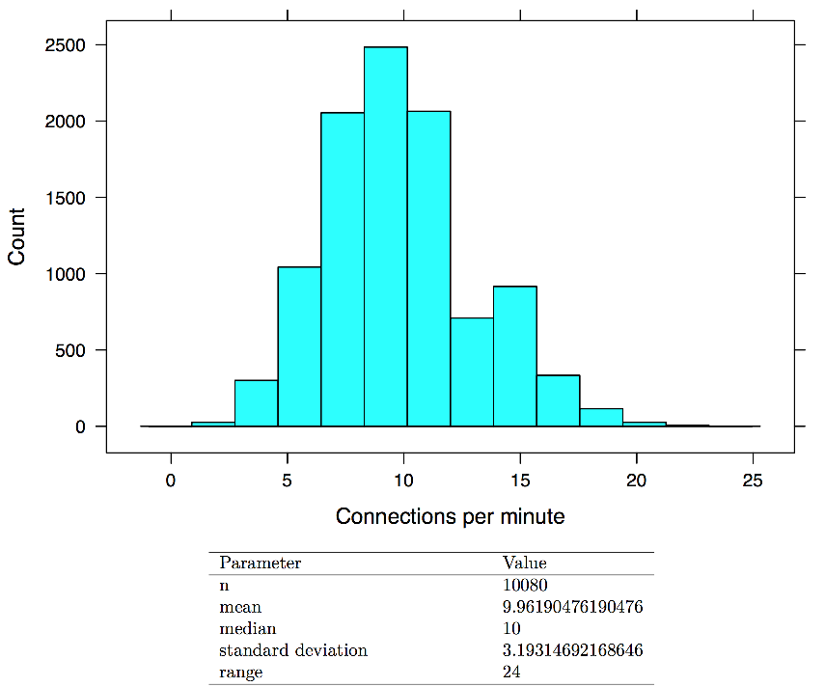
Distributions - Poisson

Slide 43
Distributions - Poisson
Since we defined the population as the connection counts per minute for a week, we have sampled the entire population. Rather than make the histogram with the exact counts, we can make a histogram of the relative frequency counts which would represent the probability distribution of the variable connections per minute:

Slide 44
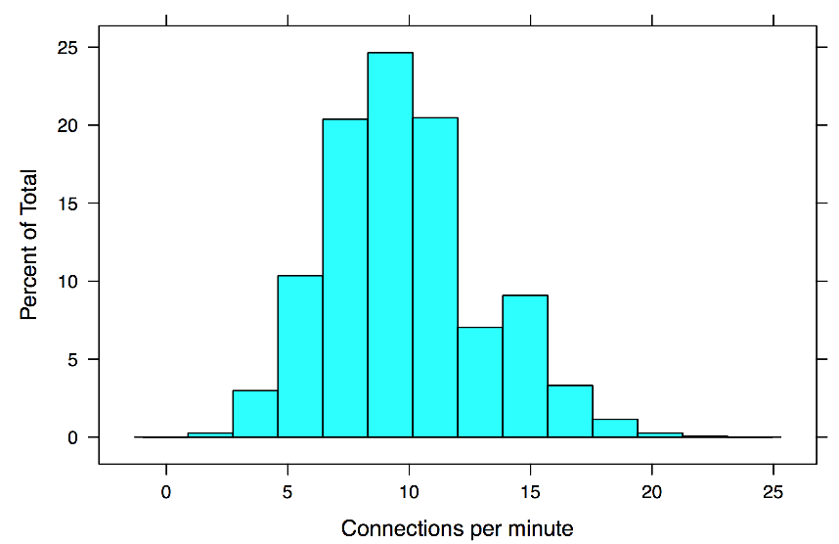
Distributions - Poisson
Notes:
Use mean of 9.96 – count the percentage 10 or below – approximately 60% Use calculator to confirm: http://stattrek.com/online-calculator/poisson.aspx

Slide 45
Distributions - Continuous
In many instances, the item under measure doesn’t have concrete stopping points
For example, take the measure of time. At any point you can theoretically measure time to any degree of precision
We normally discretize time by using whole values in the form of seconds, minutes, hours or subsets of these
For measurements that can take on an infinitely precise value, the distribution of values is said to be continuous.
Notes:
This now brings us to continuous, as opposed to discrete, random variables. In the review of frequency, we used counts that were whole numbers. While this makes sense when counting objects, in many instances, the item under measure doesn’t have such concrete stopping points. For instance, take the measure of time. At any point you can theoretically measure time to any degree of precision, but normally we discretize it by using whole values in the form of seconds, minutes, hours or subsets of these. For measurements that can take on an infinitely precise value, the distribution of values is said to be continuous.

Slide 46
Distributions – Normal (Gaussian)
Found to frequently occur naturally
Critical to probability and statistics because of the *central limit theorem*
The central limit theorem states that if one were to take an infinite number of same sized samples from a population (regardless of the distribution of the population) and calculate the mean for each sample, the resulting distribution of the sample means would be approximately a normal distribution with the mean of the sample distribution approaching the mean of the population distribution.
Important because it is often impossible to collect all values for a population, so we are left with samples from which to make inferences about the population from which they were derived.
Notes:
This distribution was found to frequently occur naturally, and is critical to probability and statistics because of the *central limit theorem*. The central limit theorem states that if one were to take an infinite number of same sized samples from a population (regardless of the distribution of the population) and calculate the mean for each sample, the resulting distribution of the sample means would be approximately a normal distribution with the mean of the sample distribution approaching the mean of the population distribution.
The reason this is important is because it is often impossible to collect all values for a population, so we are left with samples from which to make inferences about the population from which they were derived.

Slide 47
Distributions – Normal (Gaussian)
The normal distribution is continuous (having an infinite number of values as opposed to being discrete like we make with bins), unimodal (single mode), symmetric (equal halves), asymptotic (the tails keep going without touching the x-axis), and the mode = median = mean. The function that defines a normal distribution is:
Notes:
One of the most important continuous distributions is the normal, or gaussian, distribution. The normal distribution is continuous (having an infinite number of values as opposed to being discrete like we make with bins), unimodal (single mode), symmetric (equal halves), asymptotic (the tails keep going without touching the x-axis), and the mode = median = mean. The function that defines a normal distribution is:$$f(X) = \ \frac{1}{{\sigma \sqrt {2\pi } }}e^{{{ - \left( {x - \mu } \right)^2 } \mathord{\left/ {\vphantom {{ - \left( {x - \mu } \right)^2 } {2\sigma ^2 }}} \right. \kern-\nulldelimiterspace} {2\sigma ^2 }}}$$

Slide 48
Correlation
Often, one of the most basic questions you will have about two processes is how they are related to each other
Example - the number of machines infected with bot software on a network and the amount of traffic within the network may be positively correlated as infected machines try to connect to and infect other machines on the network. Other processes may be negatively correlated, such as might be the case between the number of access controls and the number of infected machines
Notes:
Often, one of the most basic questions you will have about two processes is how they are related to each other. For example, the number of machines infected with bot software on a network and the amount of traffic within the network may be positively correlated as infected machines try to connect to and infect other machines on the network. Other processes may be negatively correlated, such as might be the case between the number of access controls and the number of infected machines. With positive correlation, increases in one measure are associated with increases in the other, while with negative correlation, increases in one measure are associated with decreases in the other measure. Some measures may not be related at all, with change in one having no apparent relationship to change in another.

Slide 49
Correlation
With positive correlation, increases in one measure are associated with increases in the other
With negative correlation, increases in one measure are associated with decreases in the other measure
Some measures may not be related at all, with change in one having no apparent relationship to change in another
Notes:
When examining the potential association between two measures or variables, a frequently used measure of the relationship is the Pearson Product-Moment Correlation. The Pearson Product-Moment Correlation, abbreviated *r*, is a value between -1 and +1 which indicates the strength and direction of the linear association between the two variables. An r value of $\pm 1$ would indicate a perfect correlation between the two variables, while an r value of $0$ would indicate no association between the variables at all. An r value greater than $0$ and up to $\pm 1$ would represent a stronger, but not perfect, association between the two variables. Typically, when examining the potential relationship between two variables, you will want to do so by both visualizing the relationship and by calculating a measure of the association like *r*. Visualizing the relationship is important because you can often see issues that might affect your calculation of a measure of association, such as issues with linearity (a non-linear relationship) and outliers (single values that are very different from the others). You can also often see the magnitude and direction of the association.

Slide 50
Correlation - Pearson Product-Moment Correlation
Abbreviated r, is a value between -1 and +1 which indicates the strength and direction of the linear association between the two variables.
An r value of ±1 would indicate a perfect correlation between the two variables, while an r value of 0 would indicate no association between the variables at all
An r value greater than 0 and up to ±1 would represent a stronger, but not perfect, association between the two variables.
Notes:
When examining the potential association between two measures or variables, a frequently used measure of the relationship is the Pearson Product-Moment Correlation. The Pearson Product-Moment Correlation, abbreviated r, is a value between -1 and +1 which indicates the strength and direction of the linear association between the two variables. An r value of ±1 would indicate a perfect correlation between the two variables, while an r value of 0 would indicate no association between the variables at all. An r value greater than 0 and up to ±1 would represent a stronger, but not perfect, association between the two variables.

Slide 51
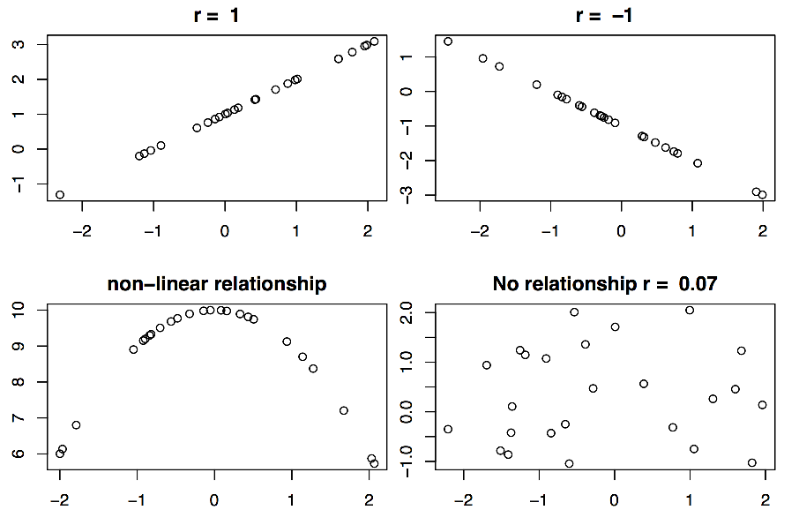
Correlation - Pearson Product-Moment Correlation
Notes:
Typically, when examining the potential relationship between two variables, you will want to do so by both visualizing the relationship and by calculating a measure of the association like r. Visualizing the relationship is important because you can often see issues that might affect your calculation of a measure of association, such as issues with linearity (a non-linear relationship) and outliers (single values that are very different from the others). You can also often see the magnitude and direction of the association.

Slide 52
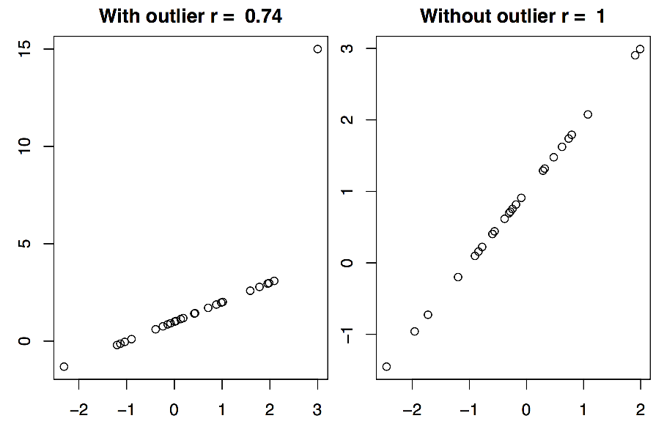
Correlation - Pearson Product-Moment Correlation
Notes:
Typically, when examining the potential relationship between two variables, you will want to do so by both visualizing the relationship and by calculating a measure of the association like r. Visualizing the relationship is important because you can often see issues that might affect your calculation of a measure of association, such as issues with linearity (a non-linear relationship) and outliers (single values that are very different from the others). You can also often see the magnitude and direction of the association.

Slide 53
Correlation - Pearson Product-Moment Correlation
To calculate the value of *r*:
calculate the *covariance*, or the average product of the the deviations of each $X$ and $Y$ value from their mean
rather than multiplying the deviation by itself as in variance, multiply the deviations together
sum all the deviations and divide by the number of values you have:
Notes:
To calculate the value of *r*, you first want to calculate how the two variables vary with respect to each other, known as the *covariance*. The covariance is the average product of the the deviations of each $X$ and $Y$ value from their mean. Just like we did when calculating the variance and the standard deviation, we subtract the $X$ or $Y$ value from the mean for that value $\bar{X}$ or $\bar{Y}$. For the *covariance* though, rather than multiplying the deviation by itself, you multiply the deviations together, then sum all the deviations and divide by the number of values you have:$$cov(X,Y)= \frac{\displaystyle\sum_{i=1}^{n}(X_i - \bar{X})(Y_i - \bar{Y})}{N-1}$$

Slide 54
Correlation - Pearson Product-Moment Correlation
To standardize the covariance and get our value for *r*, we divide the covariance by the product of the standard deviations for *x* and *y*:
Notes:
To standardize the covariance and get our value for *r*, we divide the covariance by the product of the standard deviations for *x* and *y*:$$\frac{cov(X,Y)}{s_x s_y}$$ OR $$r_{xy} = \frac{\frac{1}{N-1}\displaystyle\sum_{i=1}^{n}(X_i - \bar{X})(Y_i - \bar{Y})}{s_x s_y}$$

Slide 55
Correlation - Pearson Product-Moment Correlation
A value related to *r* that is important for understanding the relationship between two variables is the square of r
The value of r^2 is the amount of variance in one variable (y) accounted for by the relationship it has with the other variable (x)
If there is a perfect correlation between the two variables, than all the variance in one is accounted by the other
The smaller the value of *r*, the less variance accounted for by the relationship
Notes:
A value related to *r* that is important for understanding the relationship between two variables is the square of r, $r^2$. The value of $r^2$ is the amount of variance in one variable (y) accounted for by the relationship it has with the other variable (x). If there is a perfect correlation between the two variables, than all the variance in one is accounted by the other. The smaller the value of *r*, the less variance accounted for by the relationship.

Slide 56
Self-Quiz
Calculate the covariance and correlation between X and Y:
X | Y
2 | 2
3 | 2
5 | 8
4 | 4
3 | 6
1 | 2

Slide 57
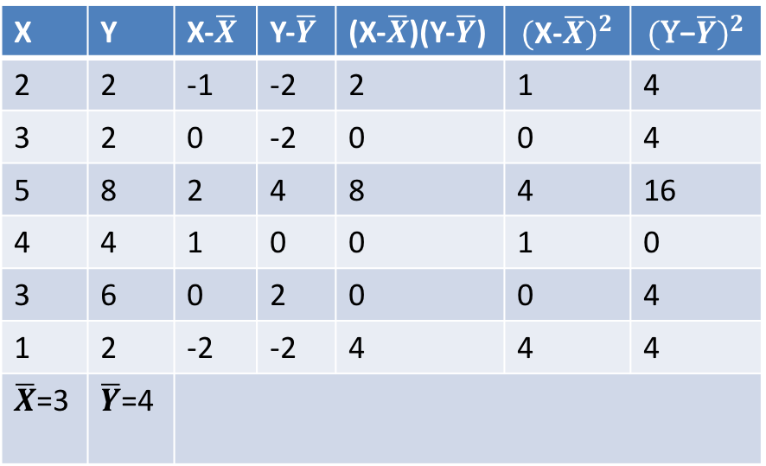
Self-Quiz
Calculate the covariance and correlation between X and Y:
X | Y | X-$\overline{X}$ | Y-$\overline{Y}$ | (X-$\overline{X}$)(Y-$\overline{Y}$) | $${(\text{X}\text{−}\overline{X})}^{2}$$ | $${(\text{Y}\text{−}\overline{Y})}^{2}$$
2 | 2 | -1 | -2 | 2 | 1 | 4
3 | 2 | 0 | -2 | 0 | 0 | 4
5 | 8 | 2 | 4 | 8 | 4 | 16
4 | 4 | 1 | 0 | 0 | 1 | 0
3 | 6 | 0 | 2 | 0 | 0 | 4
1 | 2 | -2 | -2 | 4 | 4 | 4
$\overline{X}$=3 | $\overline{Y}$=4

Slide 58
Self-Quiz
Covariance between X and Y:

Slide 59
Self-Quiz
Correlation between X and Y:

Slide 60
Linear Regression
The goal of linear regression is to be able to predict a new value (Y) based on the relationships previously seen
Given a predictor and outcome variable, one needs to find values for the line that models that relationship such that the error in prediction of y is minimized
The equation for a line is y=mx+b, where m is the slope (rise/run}, x is the known value, and b is the y-intercept, or the value of y when x = 0
Notes:
Since we know the equations for z-scores and r, we can put them together to generate the regression equation for raw scores, but a little explanation beforehand would likely help. Remember back to school when you learned that the equation for a line is $y=mx+b$, where m is the slope ($\frac{rise}{run}$), x is the known value, and b is the y-intercept, or the value of y when x = 0. The goal of linear regression is to find values for the line such that the error in prediction of y is minimized. When we draw a best fit line through known values of x and y, the line will be above some values and below others, so in order to have all positive errors for summing, we take the sum of the square the difference between the actual value of y and the predicted value, or the error in prediction:$$\sum(Y-Y')^2$$

Slide 61
Linear Regression
Since we know the equations for z-scores and r, we can put them together to generate the regression equation for raw scores:
Notes:
As measures of correlation are standardized values that provide an indication of the relationship between two variables, given *r* and the standardized score for x ($z_x$), we can predict the standardized value for y ($z_y$) using the equation:$$z'_y = rz_x$$
$$Y-\bar{Y} = m * (-\bar{X}+X)$$
$$Y-\bar{Y} = -m\bar{X}+mX$$
$$Y = (\bar{Y}-m\bar{X})+mX$$

Slide 62
Linear Regression
When we draw a best fit line through known values of x and y, the line will be above some values and below others, so in order to have all positive errors for summing, we take the sum of the square the difference between the actual value of y and the predicted value, or the error in prediction:
Notes:
Since we know the equations for z-scores and r, we can put them together to generate the regression equation for raw scores, but a little explanation beforehand would likely help. Remember back to school when you learned that the equation for a line is $y=mx+b$, where m is the slope ($\frac{rise}{run}$), x is the known value, and b is the y-intercept, or the value of y when x = 0. The goal of linear regression is to find values for the line such that the error in prediction of y is minimized. When we draw a best fit line through known values of x and y, the line will be above some values and below others, so in order to have all positive errors for summing, we take the sum of the square the difference between the actual value of y and the predicted value, or the error in prediction:$$\sum(Y-Y')^2$$

Slide 63
Linear Regression
The line that minimizes the sum of the squared error in prediction for a given sample is one that goes through the intersection of their mean values since if there is no relationship between x and y, the best guess for the value y given any value x would be the mean of y, and vice versa.
If a relationship does exist between x and y, the best guess for the y value associated with the mean value of x would still be the mean value of y, but as you move away from the mean of x, you would also move away from the mean of y depending on the nature of the relationship (either positive or negative).
As such, we can use the point (mean_x, mean_y) as one known point on the line
Notes:
It turns out that the line that minimizes the sum of the squared error in prediction for a given sample is one that goes through the intersection of their mean values ($\bar{x},\bar{y}$), since if there is no relationship between x and y, the best guess for the value y given any value x would be the mean of y ($\bar{y}$), and vice versa. If a relationship does exist between x and y, the best guess for the y value associated with the mean value of x would still be the mean value of y, but as you move away from the mean of x, you would also move away from the mean of y depending on the nature of the relationship (either positive or negative). As such, we can use the point ($\bar{x},\bar{y}$) as one known point on the line. Returning to correlation and z-scores, we can see with a little substitution and algebraic manipulation that the raw score equation for predicting a value y is given by:
As measures of correlation are standardized values that provide an indication of the relationship between two variables, given *r* and the standardized score for x ($z_x$), we can predict the standardized value for y ($z_y$) using the equation:$$z'_y = rz_x$$

Slide 64
Linear Regression
Returning to correlation and z-scores, we can see with a little substitution and algebraic manipulation that the raw score equation for predicting a value y is given by:
Notes:
Returning to correlation and z-scores, we can see with a little substitution and algebraic manipulation that the raw score equation for predicting a value y is given by:

Slide 65
Linear Regression

Slide 66
Linear Regression

Slide 67
Linear Regression

Slide 68
Linear Regression
Since this is the predicted, not actual Y value (unless r = 1), we use $\hat{Y}$ instead of Y and the final equation becomes:
Now, given any value of X, you can make a prediction for Y!
Notes:
Since this is the predicted, not actual Y value (unless r = 1), we use $\hat{Y}$ instead of Y and the final equation becomes:

Slide 69
Self-Quiz
Calculate the regression equation for the following known values:
X | Y
2 | 2
3 | 2
5 | 8
4 | 4
3 | 6
1 | 2

Slide 70
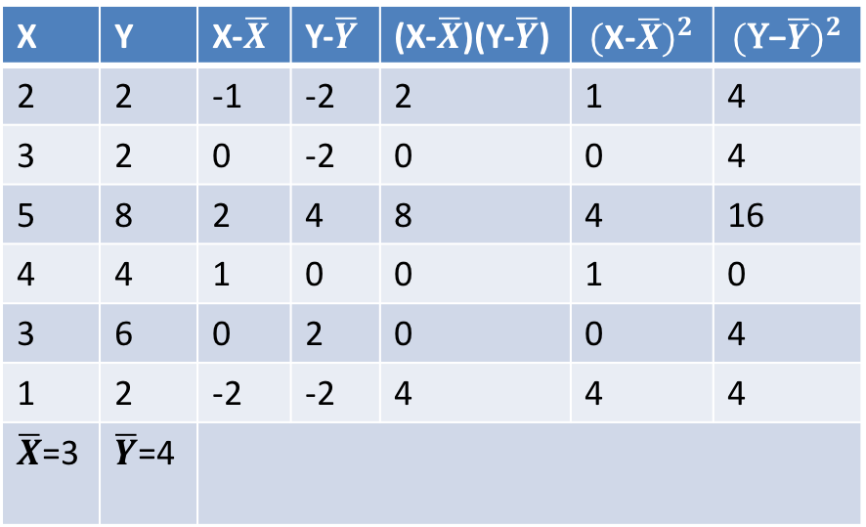
Self-Quiz
X | Y | X-$\overline{X}$ | Y-$\overline{Y}$ | (X-$\overline{X}$)(Y-$\overline{Y}$) | $${(\text{X}\text{−}\overline{X})}^{2}$$ | $${(\text{Y}\text{−}\overline{Y})}^{2}$$
2 | 2 | -1 | -2 | 2 | 1 | 4
3 | 2 | 0 | -2 | 0 | 0 | 4
5 | 8 | 2 | 4 | 8 | 4 | 16
4 | 4 | 1 | 0 | 0 | 1 | 0
3 | 6 | 0 | 2 | 0 | 0 | 4
1 | 2 | -2 | -2 | 4 | 4 | 4
$\overline{X}$=3 | $\overline{Y}$=4

Slide 71
Self-Quiz

Slide 72
Self-Quiz

Slide 73
Self-Quiz
Regression Equation:

Slide 74
Statistical Modeling and Machine Learning
Simple linear regression serves as a good example of how we can take a set of values and fit a model to it in order to predict other values
The process of fitting a model to data, or looking at a set of known relationships and abstracting an equation that best approximates the relationship in order to predict new values, is also known as *training*
Training is used in *supervised* machine learning, as one already has related data in which to approximate a relationship
If one doesn't have such data, then the computer will have to make a best effort at finding relationships in what is known as *unsupervised* machine learning
Notes:
Now, given any value of X, you can make a prediction for Y! Welcome to the wonderful world of statistical modeling and machine learning! Simple linear regression serves as a good example of how we can take a set of values and fit a model to it in order to predict other values. The process of fitting a model to data, or looking at a set of known relationships and abstracting an equation that best approximates the relationship in order to predict new values, is also known as *training*. Training is used in *supervised* machine learning, as one already has related data in which to approximate a relationship. If one doesn't have such data, then the computer will have to make a best effort at finding relationships in what is known as *unsupervised* machine learning.

Slide 75
How good is our model?
We can predict a value of Y for a given X, but how close is it to the observed value of Y?
To measure how well the regression model fits the real data, we can look at the ratio of variance in the predicted values to the variance in the actual values:
Notes:
We'll cover a variety of supervised and unsupervised machine learning processes throughout the rest of this tutorial, but first, we need to figure out how good (or bad) our generalized model of the data is. Returning to the regression equation, while we can now predict a value of Y for a given X, you know that the predicted value for Y ($\hat{Y}$) is not likely to be the *exact* observed value for Y. To measure how well the regression model fits the real data, we can look at the ratio of variance in the predicted values to the variance in the actual values:$${r_{\hat{Y}Y}}^2 = \frac{{\sigma^2}_{\hat{Y}}}{{\sigma^2}_{Y}} = \frac{\frac{\displaystyle\sum(\hat{Y} - \bar{Y})^2}{N}}{\frac{\displaystyle\sum(Y - \bar{Y})^2}{N}} = \frac{\displaystyle\sum(\hat{Y} - \bar{Y})^2}{\displaystyle\sum(Y - \bar{Y})^2}$$

Slide 76
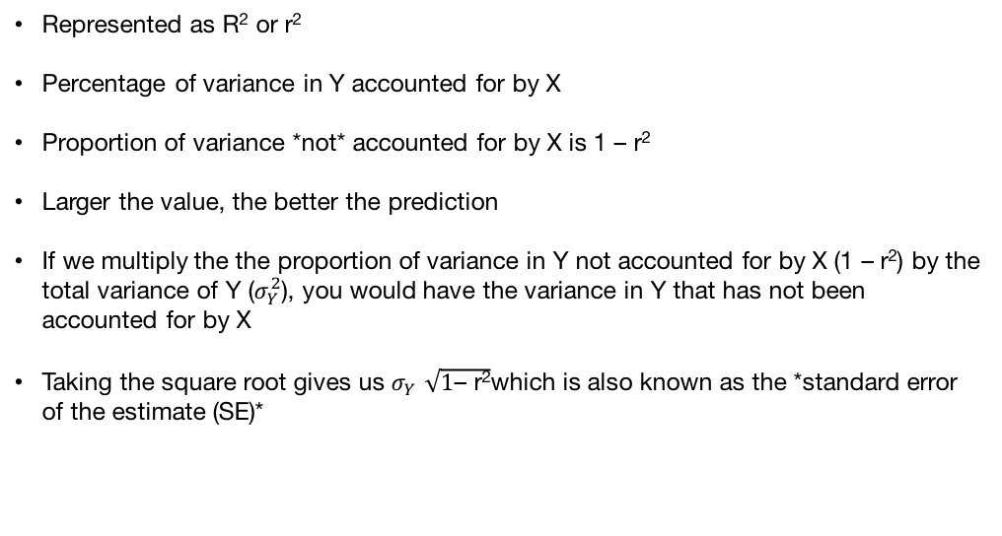
Coefficient of Determination
Represented as R² or r²
Percentage of variance in Y accounted for by X
Proportion of variance *not* accounted for by X is 1 – r²
Larger the value, the better the prediction
If we multiply the the proportion of variance in Y not accounted for by X (1 – r²) by the total variance of Y ($σ_{Y}^{2}$), you would have the variance in Y that has not been accounted for by X
Taking the square root gives us $σ_{Y }\sqrt{\text{1}\text{–} \text{r}\text{2}}$which is also known as the *standard error of the estimate (SE)*
Notes:
This value, called the *Coefficient of Determination* is the percentage of variance in Y accounted for by X. Just like with the Pearson r, the larger the value of ${r_XY}^2$, the better the prediction. Given that ${r_XY}^2$ is the proportion of variance in Y that has been accounted for by X, the proportion of variance in Y not accounted for by X would be $1 - {r_XY}^2$. If we multiply the the proportion of variance in Y not accounted for by X ($1 - {r_XY}^2$) by the total variance of Y (${\sigma^2}_Y$), you would have the variance in Y that has not been accounted for by X. Taking the square root gives us ${\sigma}_Y \sqrt{1 - {r_XY}^2}$ which is also known as the *standard error of the estimate (SE)*

Slide 77
Standard Error of Measurement
If the relationship between X and Y is linear (which it must be to make any sense out of generating a linear regression) *and* the error of predictions follow a normal distribution *and* the variance of the errors of prediction are the same throughout, then we can use the SE to place a confidence interval around the predicted value
That is, although we know that the predicted value for Y (Y_hat) is not likely to be the exact value, we can determine a range of values for Y_hat that the actual value for Y is likely to be.
This is a function of the variance in Y not accounted for by X, or the SE
Notes:
If the relationship between X and Y is linear (which it must be to make any sense out of generating a linear regression) *and* the error of predictions follow a normal distribution *and* the variance of the errors of prediction are the same throughout, then we can use the SE to place a confidence interval around the predicted value. That is, although we know that the predicted value for Y ($\hat{Y}$) is not likely to be the exact value, we can determine a range of values for $\hat{Y}$ that the actual value for Y is likely to be. This is a function of the variance in Y not accounted for by X, or the SE. If we take the predicted value for Y ($\hat{Y}$) and, since we are assuming the error variance is normally distributed around the predicted value, find the Z-score associated with the confidence interval (CI) we are interested in (so for a 95% CI we would use Z = 1.96 as can be seen in a table of normal distribution), we can create a range of scores around $\hat{Y}$ in which we can be 95% confident that the true value of Y exists. The equation to do this is:$$\hat{Y} \pm Z_{CI} * SE$$

Slide 78
Standard Error of Measurement
Take the predicted value for Y (Y_hat)
Assuming the error variance is normally distributed around the predicted value, find the Z-score associated with the confidence interval (CI) we are interested in
For a 95% CI we would use Z = 1.96 as can be seen in a table of normal distribution
Create a range of scores around Y_hat in which we can be 95% confident the true value of Y exists
The equation to do this is:
Notes:
If we take the predicted value for Y ($\hat{Y}$) and, since we are assuming the error variance is normally distributed around the predicted value, find the Z-score associated with the confidence interval (CI) we are interested in (so for a 95% CI we would use Z = 1.96 as can be seen in a table of normal distribution), we can create a range of scores around $\hat{Y}$ in which we can be 95% confident that the true value of Y exists. The equation to do this is:$$\hat{Y} \pm Z_{CI} * SE$$

Slide 79
Standard Error of Measurement
So if we had a predicted value Y_hat of 6 and a SE of 1, we could be 95% certain that the true value of Y is in the range:

Slide 80
Self-Quiz
Calculate the range of values for Y with a 95% CI given for the following known values
X | Y
2 | 2
3 | 2
5 | 8
4 | 4
3 | 6
1 | 2

Slide 81
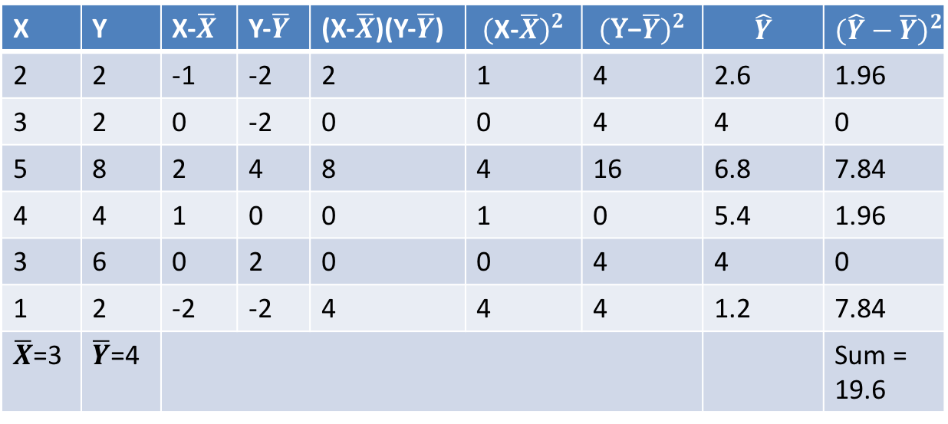
Self-Quiz
X | Y | X-$\overline{X}$ | Y-$\overline{Y}$ | (X-$\overline{X}$)(Y-$\overline{Y}$) | $${(\text{X}\text{−}\overline{X})}^{2}$$ | $${(\text{Y}\text{−}\overline{Y})}^{2}$$ | $$\hat{Y}$$ | $${(\hat{Y}−\overline{Y})}^{2}$$
2 | 2 | -1 | -2 | 2 | 1 | 4 | 2.6 | 1.96
3 | 2 | 0 | -2 | 0 | 0 | 4 | 4 | 0
5 | 8 | 2 | 4 | 8 | 4 | 16 | 6.8 | 7.84
4 | 4 | 1 | 0 | 0 | 1 | 0 | 5.4 | 1.96
3 | 6 | 0 | 2 | 0 | 0 | 4 | 4 | 0
1 | 2 | -2 | -2 | 4 | 4 | 4 | 1.2 | 7.84
$\overline{X}$=3 | $\overline{Y}$=4 |  |  |  |  |  |  | Sum = 19.6

Slide 82
Self-Quiz

Slide 83
Supervised and Unsupervised Machine Learning
Notes:
Now that you've been introduced to the basics of statistical learning, let's begin to take a look at some supervised and unsupervised machine learning tasks and how to accomplish them in 'R'. Once the basics of machine learning are covered, we'll return to the *process* of using machine learning and statistical analysis to help identify anomalies and possible security events from your security data.

Slide 84

Install Anaconda - https://www.continuum.io/downloads

Slide 85
Setup
Use link to c9.io emailed to you to create account (no credit card needed)
Get Jupyter Notebook running on Cloud9 (https://community.c9.io/t/how-to-get-jupyter-notebook-to-run-on-c9/6518/3)
Use WGET or CURL –O for downloading Conda
CHMOD as needed to make it executable
Logout and click password reset to set password for account
Use IE for running notebook

Slide 86
Hands On Data Analytics
Brownlee, Jason (2017) Machine Learning Mastery With Python

Slide 87
Python Ecosystem for Machine Learning
Brownlee, Jason (2017) Machine Learning Mastery With Python

Slide 88
Get comfortable with Python
http://www.practicepython.org

Slide 89
Setup for Machine Learning
conda install what is missing

Slide 90
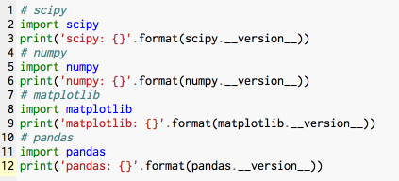
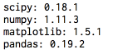
Ecosystem
Brownlee, Jason (2017) Machine Learning Mastery With Python

Slide 91
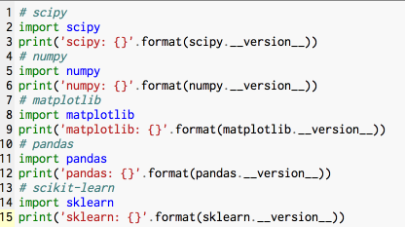
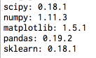
Ecosystem
Brownlee, Jason (2017) Machine Learning Mastery With Python

Slide 92
Python and Scipy
Brownlee, Jason (2017) Machine Learning Mastery With Python

Slide 93
Loading Data
Brownlee, Jason (2017) Machine Learning Mastery With Python

Slide 94
Descriptive Statistics
Brownlee, Jason (2017) Machine Learning Mastery With Python

Slide 95
Visualizations
Brownlee, Jason (2017) Machine Learning Mastery With Python

Slide 96
Prepare Data
Brownlee, Jason (2017) Machine Learning Mastery With Python

Slide 97
Feature Selection
Brownlee, Jason (2017) Machine Learning Mastery With Python

Slide 98
Evaluate Model Performance
Brownlee, Jason (2017) Machine Learning Mastery With Python

Slide 99
Performance Metrics
Brownlee, Jason (2017) Machine Learning Mastery With Python

Slide 100
Spot Check Classification Algorithms
Brownlee, Jason (2017) Machine Learning Mastery With Python

Slide 101
Spot Check Regression Algorithms
Brownlee, Jason (2017) Machine Learning Mastery With Python

Slide 102
Compare Machine Learning Algorithms
Brownlee, Jason (2017) Machine Learning Mastery With Python

Slide 103
Automate Workflows with Pipelines
Brownlee, Jason (2017) Machine Learning Mastery With Python

Slide 104
Improve Performance with Ensembles
Brownlee, Jason (2017) Machine Learning Mastery With Python

Slide 105
Improve Performance with Algorithm Tuning
Brownlee, Jason (2017) Machine Learning Mastery With Python

Slide 106
Save and Load Model
Brownlee, Jason (2017) Machine Learning Mastery With Python

Slide 107
Predictive Model Template
Brownlee, Jason (2017) Machine Learning Mastery With Python

Slide 108
Regression Case Study
Brownlee, Jason (2017) Machine Learning Mastery With Python

Slide 109
Binary Classification Case Study
Brownlee, Jason (2017) Machine Learning Mastery With Python

Slide 110
Brownlee, Jason (2017) Machine Learning Mastery With Python

